Slide 1
Post-Process Effects

Slide 2
Post-Process Effects
This concept takes its name from the fact that it happens after main rendering is complete.
A Post-Process effect will use the rendered scene information as its input, among other things.
These effects typically take place in screen space.

Slide 3
Common Post-Process Effects
Full Screen Blurs
Depth of Field
Motion Blur
Edge Detection and Highlighting
Bloom
Non-Realistic renderings
Pencil Sketch
Sepia
Fades

Slide 4
Post-Process Step
Normal scene rendering
Apply Post-Process Effect
Render resulting surface to the screen

Slide 5
Anatomy of a simple post-process blur
Render scene to off screen render target
Render full screen quad
Use the result from step 1 as the texture for the quad
In the pixel shader average neighboring texels together to get output color
???
Profit

Slide 6
Post-Process Swap Chain
We will often want to run more than one post-process effect
Depth of Field is typically achieved by doing a blur pass that is combined with the sharp image based on depth values.
Having each post-process create a new render target is wasteful
Instead we will swap between a source and destination target for each effect.

Slide 7
Post-Process Swap Chain
Set source texture
Set destination target
Render full screen quad
Swap source and destination
Begin next effect

Slide 8
Post-Process Swap Chain
For each effect
Run effect
Activate destination render target
Since these are full screen effects we probably do not need to clear, except if we change sample size, which we will.
Set source surface as input texture
Revert render target
Swap source and destination render targets
Render resulting surface to the screen

Slide 9
Post-Process Step - updated
Normal scene rendering
Apply Post-Process Swap Chain
Render resulting surface to the screen

Slide 10
Post-Process additional data
Many post-process effects need information beyond just the output colors of the scene rendering.
Effects will commonly need depth information or normals.
In a forward renderer we would have to use Multiple Render Targets in our normal pass to output this extra data.
In a deferred renderer we typically already have this data.

Slide 11
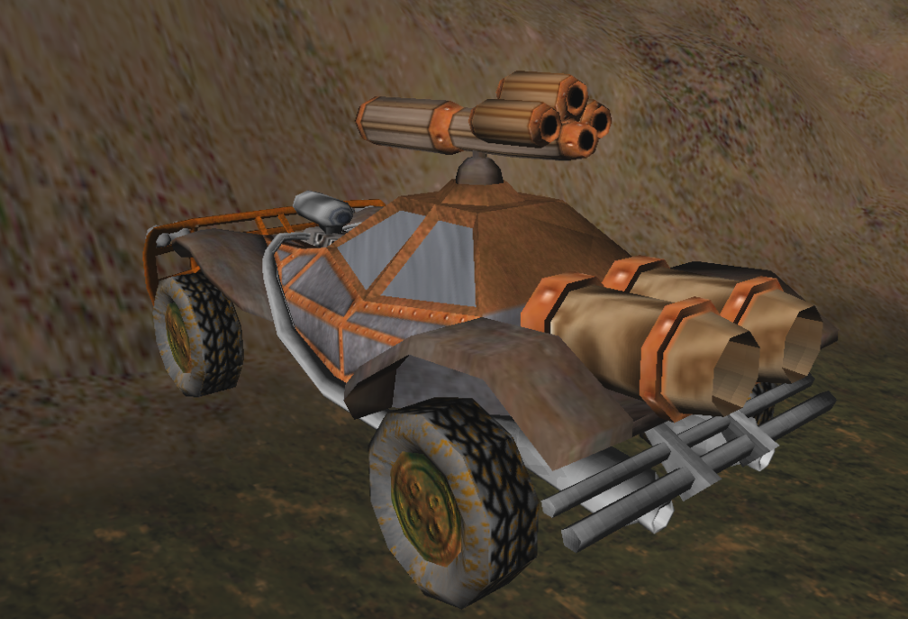
Gaussian Blur – Sharp Image

Slide 12
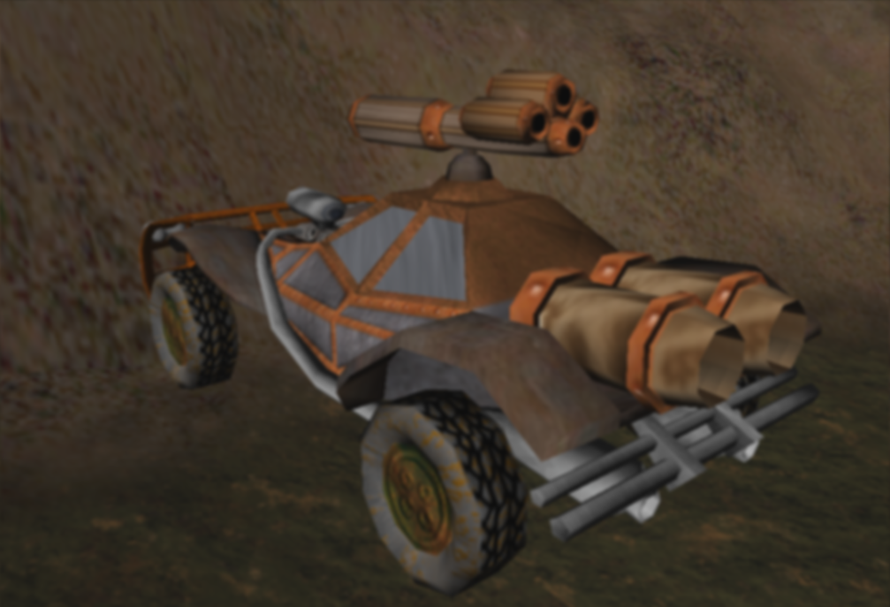
Gaussian Blur – With Blur

Slide 13
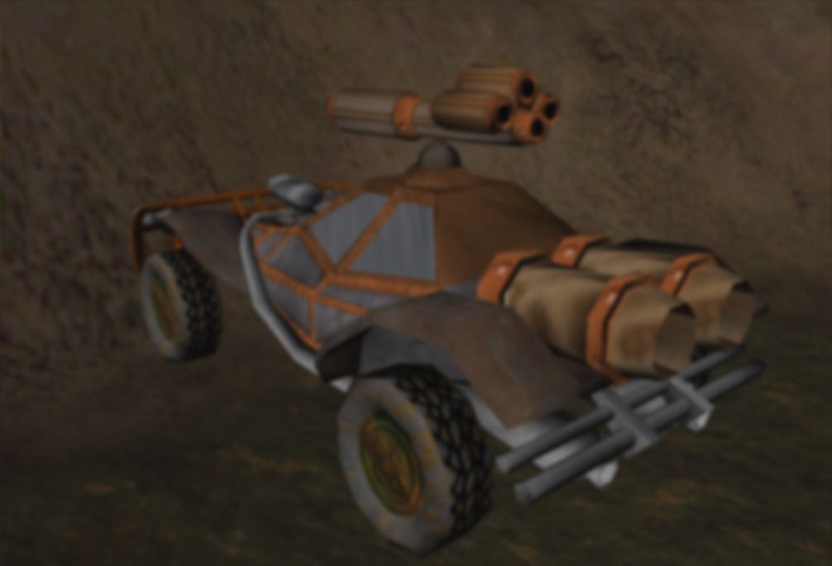
Gaussian Blur – Blur of Blur

Slide 14
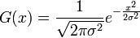
Gaussian Blur
Ultimately any type of blur is going to do some sort of averaging of neighboring pixels.
A Gaussian Blur will sample a varying number of neighbors and weight the averages based on distance, using the Gaussian function.
X is the distance from the texel
σ is the standard deviation, in simple terms make it bigger to make it blurrier.

Slide 15
Gaussian Blur
(1 / sqrt(2 * D3D_PI * StandardDeviationSquared)) * pow(M_E,
-((x * x) / (2 * StandardDeviationSquared))
We can use this formula to develop a kernel of weights for our blending
In graphics a kernel is a matrix of values that will be applied to pixels

Slide 16
Gaussian Blur
In theory we should use every pixel in our image to blur every other.
Of course this would be very slow, and pixels will have very little impact at much distance
Typical implementations will cut off at 3, 5 or 7 pixels away.
We call the samples we are blurring taps.
With 3 taps, each pixel will have to do 49 texture samples, 5 taps is 121, 7 is 225.
Multiply that by how pixels there are…

Slide 17
Gaussian Blur – Linear Seperation
We can get a big speed up by splitting the blur into horizontal and vertical passes instead of blurring the “circle” around a pixel.
We will blend only the neighboring pixels in a horizontal line.
Use the horizontal blur output as the input to the vertical blur.
We get the same result with far fewer texture samples.
3 taps is 14 samples, 5 is 22, 7 is 30.

Slide 18
Gaussian Blur - Downsampling
We can further speed up our blur by downsampling our image first.
The idea here is to render our image to a smaller target with linear texture filtering.
Apply our blur to our now smaller image.
Upsample the image back to the original size
We have fewer pixels to blur, and the process of downsampling and upsampling causes some blur on its own.

Slide 19
Gaussian Blur - uses
Blurring effects have various uses
The obvious one is to render something that should be blurry, duh.
Blurs can be used as a form of anti-aliasing where we would limit the blur effect to the edges of polygons to get softer lines
Bloom is basically a blur of the most lit sections of our scene
Blur results can be used by other effects like our Depth of Field effect.

Slide 20
Depth of Field
When you focus an optical device on something, whether it be your eye or a camera, things closer and things further away lose focus.
We can recreate this effect by blending the image of our scene with a blurred version and using the depth of the pixels to decide which of the textures to use more of.

Slide 21
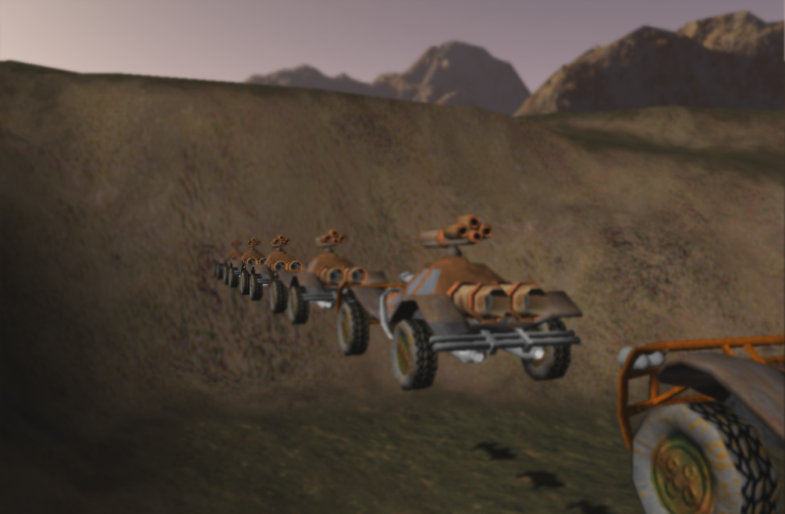
Depth of Field – Far Focus

Slide 22
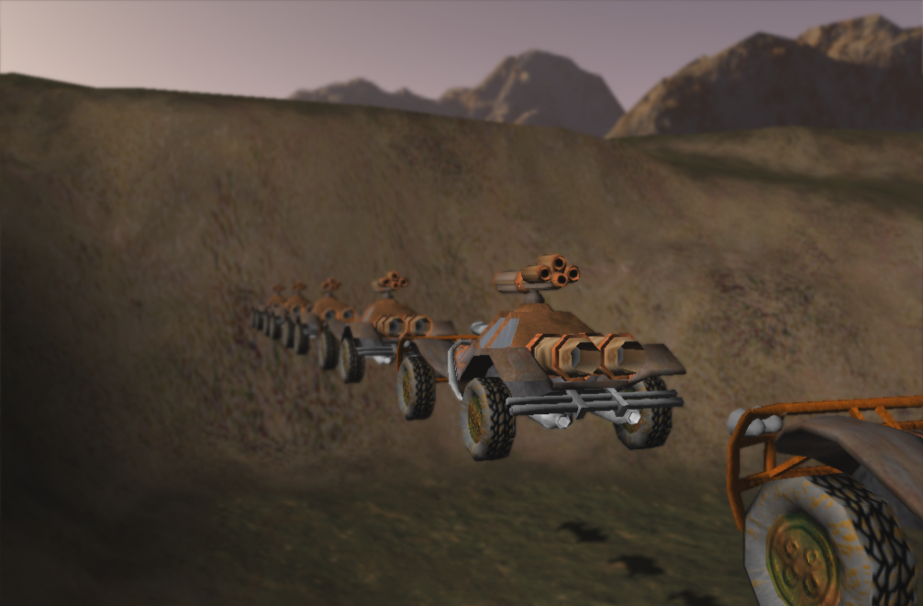
Depth of Field – Near Focus

Slide 23
Depth of Field
We will create a formula whose output will be a range from 0 to 1, telling us how much of the sharp image or blurred image to use.
We will be able to control both the distance of focus and the range around that distance that is in focus.
Blur = saturate( abs( depth – focusDistance) / focusRange);
Color = lerp(sharpColor, blurColor, Blur);

Slide 24
Depth of Field
Since we are using a deferred renderer we have a texture of depth values already, depthGBuffer.
Remember the values in our depth texture are non-linear.
These non-linear values can be hard to use, in fact a constant value for the focus range will have a different result at different focus distances, lame.
There’s got to be a better way!

Slide 25
Depth of Field
We can convert the non-linear depth values to a linear result.
PlaneX = -farClip / (farClip – nearClip)
PlaneY = -farClip * nearClip / (farClip – nearClip)
linearDepth = PlaneY / (PlaneX + depth)
As long as the near and far clip distances do not change, PlaneX and PlaneY are constant and should only be computed and set once. Making this conversion relatively cheap.

Slide 26
Edge Detection
Edge Detection is just what it sounds like, an effect that detects where edges are, then does something.
Differences in depths, normals or colors are typically used to define edges.
There are tons of effects that can be created with this.
Drawing lines to highlight edges
Finding limits to blur zones
Anti-Aliasing

Slide 27
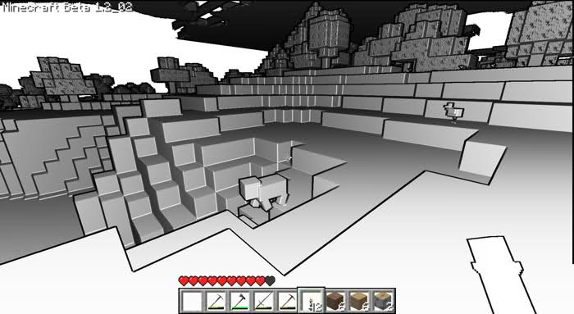
Edge Detection – MineCraft

Slide 28
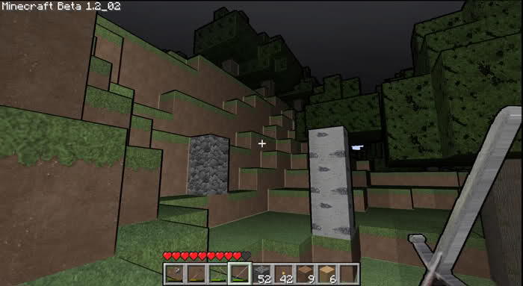
Edge Detection - MineCraft

Slide 29
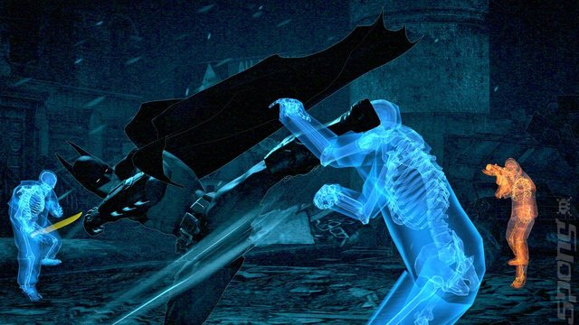
Edge Detection – Arkham City

Slide 30
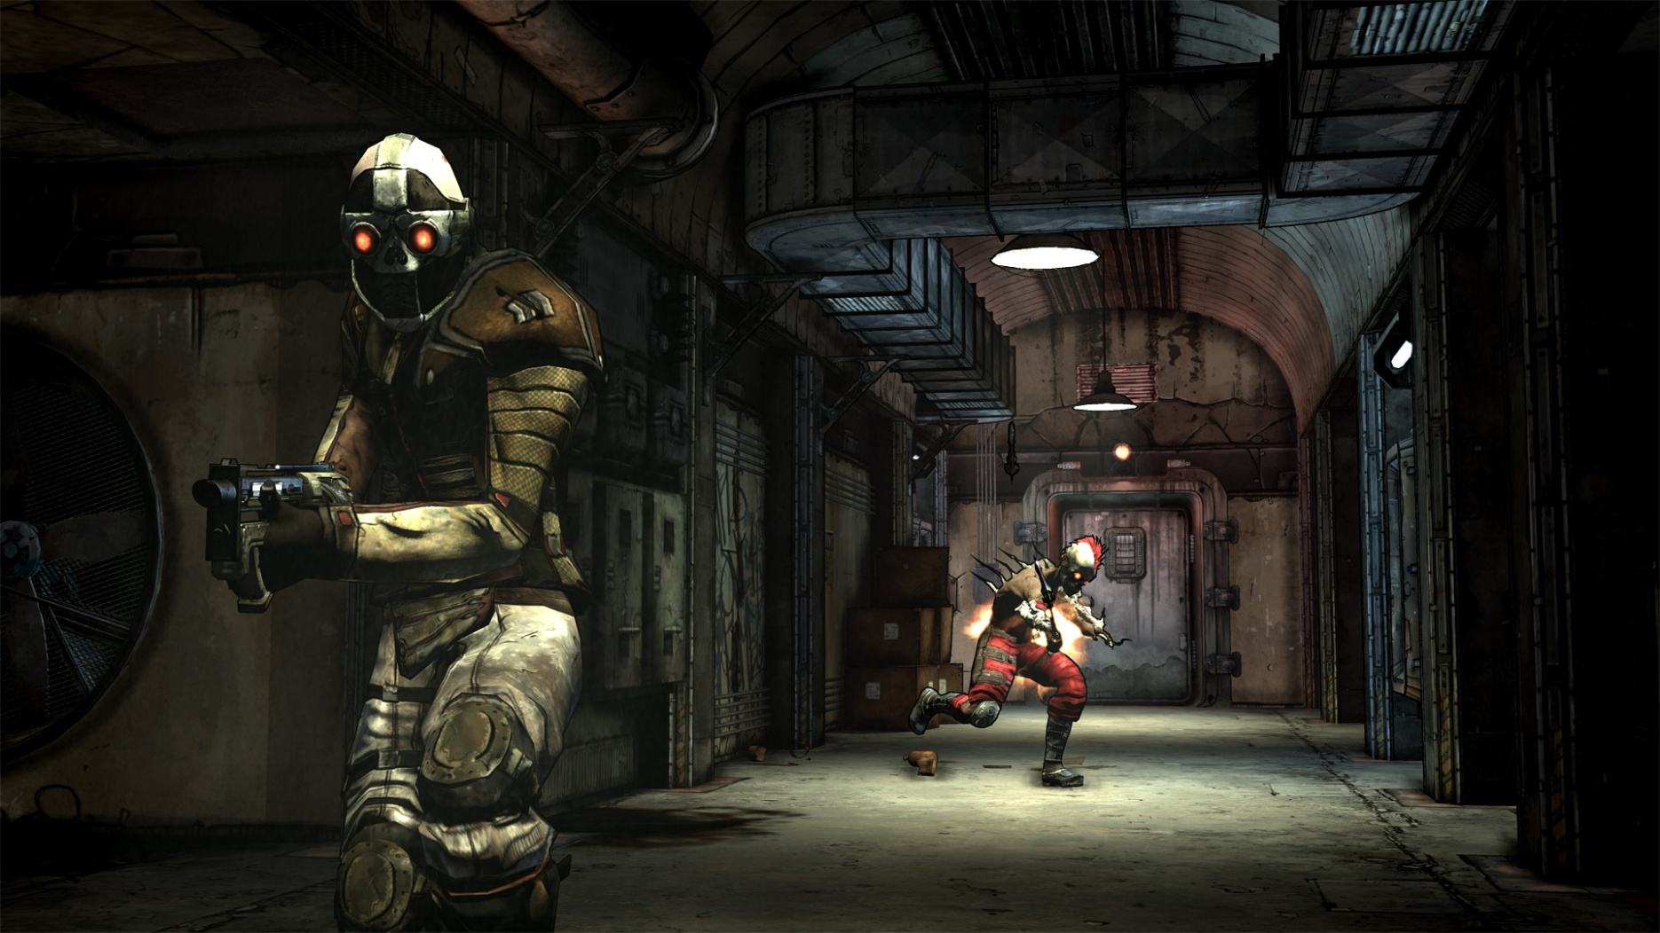
Edge Detection - Borderlands

Slide 31

Edge Detection - Borderlands

Slide 32
Edge Detection
To detect edges we will compare neighboring pixels
We can compare color, depths and normals
We can define thresholds to determine if there is enough difference to represent an edge.
When drawing the edges we can use the difference in these comparisons to define how “Edgy” a pixel is and darken the line drawn by this value.

Slide 33
Edge Detection
I would guess that Borderlands compares both normals and depths. So will our lab.
Depth values will define edges between objects.
Using normals to define edges has the interesting result of defining the edges of polygon faces, and individual objects.
Drawing edges based on normals can add a lot of detail that is not present in the diffuse texture.

Slide 34
Edge Detection
Let’s take a look at our lab, and turn on a few of these effects.
There are a ton of rendering, and other game topic, examples on the App Hub website http://create.msdn.com/en-US/
Why don’t you show the Toon Shade demo from the NonPhotoRealistic example, Burnside?

Slide 35
Combine Effects / Filters
Simple idea, we take our scene texture and combine it with another texture.
Our Depth of Field solution is a combine effect. We combine the current texture of our swap chain, which is hopefully the output of a blur, with a sharp image of our scene.
The Sketch shader effects in the NonPhotoRealistic demo combine the scene image with texture of “sketchy” lines. Like a lenses filter.
Let’s look at that demo again and check out their assets.

Slide 36
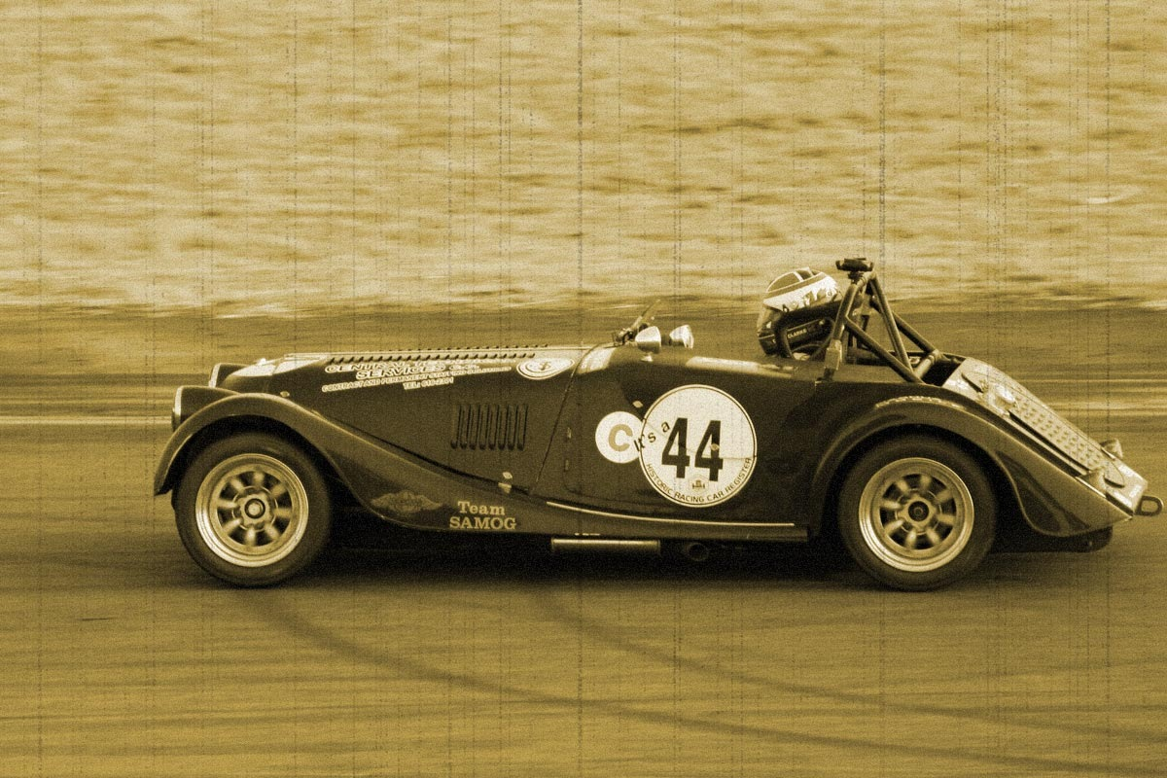
Filter

Slide 37
Bloom
The Bloom effect attempts emulate the perceived glowing of bright lights caused by the lighting of tiny particles in the air.
Remember why the sky is blue?
Bloom is typically achieved by a combination of other effects.

Slide 38
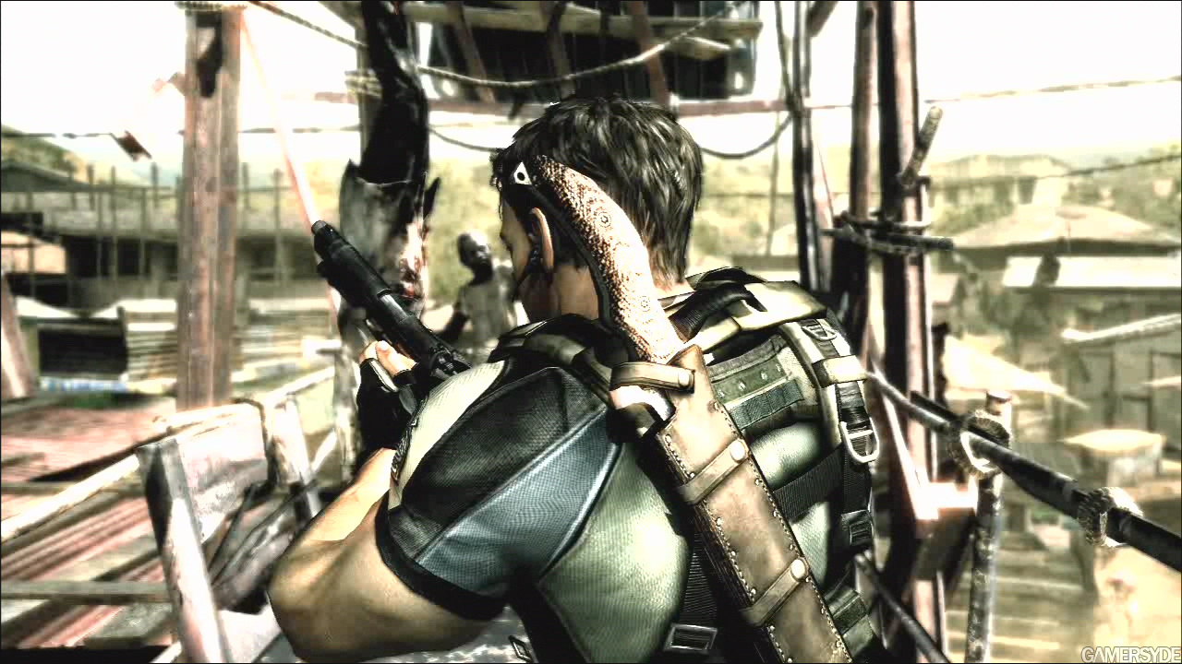
Bloom

Slide 39
Bloom
First we apply a BrightPass filter
A BrightPass filter is just another effect that scales color based on a brightness threshold, such that dark areas get darker and bright areas stay the same.
Color = saturate((Color – threshold) / ( 1 – threshold));
The result is run through a Gaussian Blur that also scales up the colors as it goes.
Ex. Color = Color * 1.5;

Slide 40
Bloom
Colors closer to white end up much brighter, while the dark section only change a little.
Lastly, the result is combined with the original scene.
The BrightPass causes the scaling to only take effect the brightest areas.
If only App Hub had a cool demo for bloom too…

Slide 41
Post-Process Effects - Summary
Effects are run in screen space
Many effects are combinations of others
We use a render target swap chain to reduce the number of targets created and to make it easier to add and remove effects
Let’s look at one last demo of Post-Process effects, this time from the DX Sample Browser.

